Slide 1
Parallel Performance: Analysis and Evaluation
Lecture TBD
Course TBD
Term TBD

Slide 2
Review
Performance evaluation of parallel programs

Slide 3
Speedup
Sequential Speedup
S_{seq} = Exec_{orig}/Exec_{new}
Parallel Speedup
S_{par} = Exec_{seq}/Exec_{par}
S_{par} = Exec₁/Exec_{N}
Linear Speedup
S_{par} = N
Super Linear Speedup
S_{par} > N

Slide 4
Amdahl’s Law for Parallel Programs
Speedup is bounded by the amount of parallelism available in the program
If the fraction of code that runs in parallel is p then maximum speedup that can be obtained with N processors
ExTime_{new} = (ExTime_{seq} * p * 1/N) + (ExTime_{seq} * (1 – p))
ExTime_{par} = ExTime_{seq} * ((1 – p) + p/N)
Speedup = ExTime_{seq}/ExTime_{par}
= 1/((1-p) + p/N)
= N / (N (1 –p) + p)

Slide 5
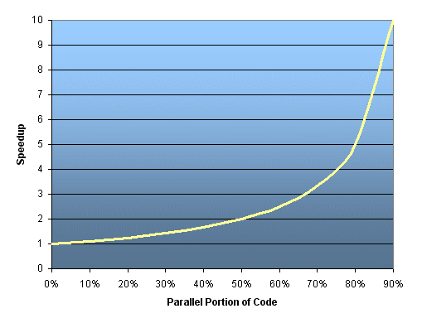
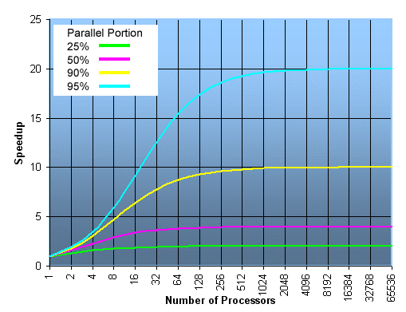
Scalability
max speedup in relation to number of processors
max theoretical speedup

Slide 6
Scalability
Program continues to provide speedups as we add more processing cores
Does Amdahl’s Law hold for large values of N for a particular program
The ability of a parallel program's performance to scale is a result of a number of interrelated factors
The algorithm may have inherent limits to scalability

Slide 7
Strong and Weak Scaling
Strong Scaling
Adding more cores allows us to solve the problem faster
e.g., fold the same protein faster
Weak Scaling
Adding more cores allows us to solve larger problem
e.g., fold a bigger protein

Slide 8


The Road to High Performance
petaflop
teraflop
gigaflop
Celebrating 20 years

Slide 9

The Road to High Performance
multicores
arrive
Celebrating 20 years

Slide 10

Lost Performance
1993 1995 1997 1999 2001 2003 2005 2007 2009 2011 2013
Celebrating 20 years

Slide 11

Need More Than Performance
GPUs
arrive
No power data prior to 2003
Celebrating 20 years

Slide 12
Communication Costs
Algorithms have two costs
Arithmetic (FLOPS)
Communication: moving data between
levels of a memory hierarchy (sequential case)
processors over a network (parallel case).
CPU
Cache
CPU
DRAM
CPU
DRAM
DRAM
CPU
DRAM
CPU
DRAM
Slide source: Jim Demmel, UC Berkeley

Slide 13
Avoiding Communication
Running time of an algorithm is sum of 3 terms:
# flops * time_per_flop
# words moved / bandwidth
# messages * latency
communication
Annual improvements
Time_per_flop |  | Bandwidth | Latency
 | Network | 26% | 15%
 | DRAM | 23% | 5%
59%
Goal : organize code to avoid communication
Between all memory hierarchy levels
L1 L2 DRAM network
Not just hiding communication (overlap with arith) (speedup ≤ 2x )
Arbitrary speedups possible

Slide 14

Power Consumption in HPC Applications
Data from NCOMMAS weather modeling applications on AMD Barcelona

Slide 15
Techniques For Improving Parallel Performance
Data locality
Thread Affinity
Energy

Slide 16
Memory Hierarchy : Single Processor
On-Chip Components
Control
Instr
Cache
Secondary
Memory
(Disk)
ITLB
Second
Level
Cache
(L2)
Main
Memory
(DRAM)
Datapath
RegFile
DTLB
Data
Cache
Speed (cycles): ½ 1’s 10’s 100’s 10,000’s
Size (bytes): 100’s 10K’s M’s G’s T’s
Cost per byte: highest lowest
Nothing gained without locality

Slide 17
Types of Locality
Temporal Locality (locality in time)
If a memory location is referenced then it is likely that it will be referenced again soon
⇒ Keep most recently accessed data items closer to the processor
Spatial Locality (locality in space)
If a memory location is referenced, the locations with nearby addresses are likely to be referenced soon
⇒ Move blocks consisting of contiguous words closer to the processor
demo

Slide 18
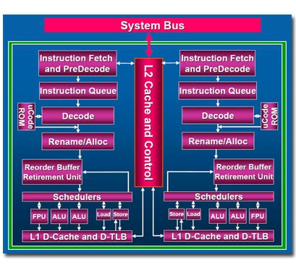
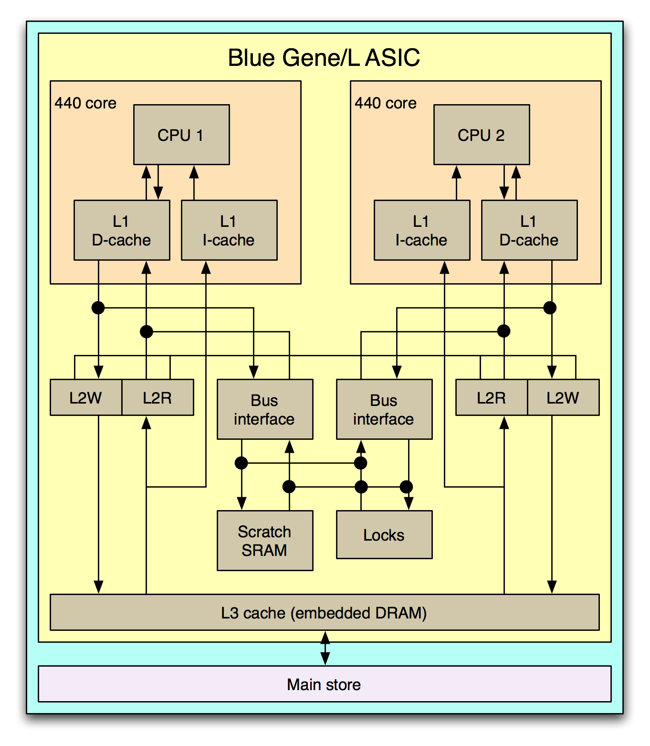
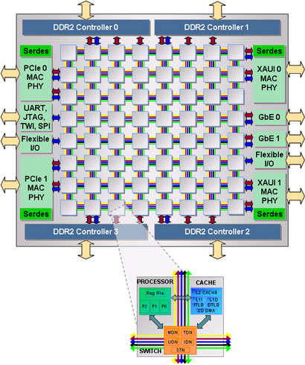
Shared-caches on Multicores
Intel Core 2 Duo
Blue Gene/L
Tilera64

Slide 19
Data Parallelism
D = data
D/p
D/p
D/p
D/p
D

Slide 20
Data Parallelism
typically, same task
on different parts of
the data
D = data
spawn
D/p
D/p
D/p
D/p
D
synchronize

Slide 21
Shared-cache and Data Parallelization
intra-core locality
D
D/k
D/k
D/k
D/k
D/k ≤ Cache Capacity
D

Slide 22
Tiled Data Access
individual thread
k
j
i
“unit” sweep
parallelization over i, j, k
no blocking
“plane” sweep
parallelization over k
no blocking
“beam” sweep
blocking of i and j
parallellization over ii and jj

Slide 23
Data Locality and Thread Granularity
k
Reduced granularity
Improved intra-core locality
j
i
thread
granularity
reuse over time, multiple sweeps over working set
smaller working set per thread

Slide 24
Exploiting Locality With Tiling
// parallel region
thread_construct()
...
// repeated access
for j = 1, M
... a[i][j] ...
... b[i][j] ...
for j = 1, M, T
// parallel region
thread_construct()
...
// repeated access
for jj = j, j + T - 1
... a[i][jj] ...
... b[i][jj] ...

Slide 25
Exploiting Locality With Tiling
// parallel region
for i = 1, N
...
// repeated access
for j = 1, M
... a[i][j] ...
... b[i][j] ...
for j = 1, M, T
// parallel region
for i = 1, N
...
// repeated access
for jj = j, j + T - 1
... a[i][jj] ...
... b[i][jj] ...
demo

Slide 26
Locality with Distribution
// parallel region
thread_construct()
...
for j = 1, N
for i = 1, M
...
a(i,j)
...
// parallel region
thread_construct()
...
for j = 1, N
for i = 1, M
...
b(i,j)
...
// parallel region
thread_construct()
...
for j = 1, N
for i = 1, M
...
a(i,j)
b(i,j)
...
reduces threads granularity
improves intro-core locality

Slide 27
Locality with Fusion
// parallel region
thread_construct()
...
for j = 1, N
for i = 1, M
...
a(i,j)
...
// parallel region
thread_construct()
...
for j = 1, N
for i = 1, M
...
b(i,j)
...
// parallel region
thread_construct()
...
for j = 1, N
for i = 1, M
...
a(i,j)
b(i,j)
...

Slide 28
Combined Tiling and Fusion
// parallel region
thread_construct()
...
for j = 1, N
for i = 1, M
...
a(i,j)
...
// parallel region
thread_construct()
...
for j = 1, N
for i = 1, M
...
b(i,j)
...
for i = 1, M, T
// parallel region
thread_construct()
for ii = i, i + T - 1
= a(ii,j)
= b(ii,j)

Slide 29
Pipelined Parallelism
Pipelined parallelism can be used to parallelize applications that exhibit producer-consumer behavior
Gained importance because of the low synchronization cost between cores on CMPs
Being used to parallelize programs that were previously considered sequential
Arises in many different contexts
Optimization problems
Image processing
Compression
PDE solvers

Slide 30
Pipelined Parallelism
P
C
Shared
Data Set
P
C
Synchronization window
Any streaming application : Netflix
Notes:
2-core model - simple extensions for more cores

Slide 31
Ideal Synchronization Window
P
C
Shared
Data Set
P
C
inter-core data locality
Notes:
2-core model - simple extensions for more cores

Slide 32
Synchronization Window Bounds
Bad
Not as
bad
Better?
Notes:
2-core model - simple extensions for more cores

Slide 33
Thread Affinity
Binding a thread to a particular core
Soft affinity
Affinity suggested by programmer/software; may or may not be honored by OS
Hard affinity
affinity suggested by system software/runtime system; honored by OS

Slide 34
Thread Affinity and Performance
Temporal Locality
A thread running on the same core throughout it’s lifetime will be able to exploit the cache
Resource usage
Shared caches
TLBs
Prefetch units
…

Slide 35
Thread Affinity and Resource Usage
Key idea
If thread i and j have favorable resource usage then bind them to the same “cohort”
If thread i and j have unfavorable resource usage then bind them to different “cohorts”
A cohort is a group of cores that share resources
demo

Slide 36
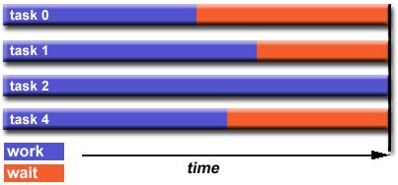
Load Balancing
This one dominates!

Slide 37
Thread Affinity Tools
GNU + OpenMP
Environment variable GOMP_CPU_AFFINITY
Pthreads
pthread_setaffinity_np()
Linux API
sched_setaffinity()
Command line tools
taskset

Slide 38
Power Consumption
Improved power consumption does not always coincide with improved performance
In fact, for many applications it is the opposite
P = CV²f
Need to account for power, explicitly

Slide 39
Optimizations for Power
Techniques are similar but objectives are different
Fuse code to get a better mix of instructions
Distribute code to separate and FP-intensive tasks
Can use affinity to reduce overall system power consumption
Bind hot-cold tasks to same cohort
Distribute hot-hot tasks across multiple cohorts
Techniques with hardware support
DVFS : slow down a subset of cores

