Slide 1
Task Orchestration : Scheduling and Mapping on Multicore Systems
Course TBD
Lecture TBD
Term TBD

Slide 2
Outline
Scheduling for parallel systems
Load balancing
Thread affinity
Resource sharing
Hardware threads (SMT)
Multicore architecture
Significance of the multicore paradigm shift

Slide 3
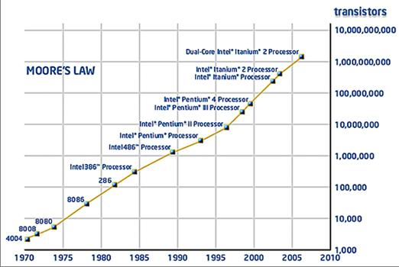
Increase in Transistor Count
Moore’s
Law

Slide 4
Increase in Performance
longer issue pipeline
double speed artihmetic
Full Speed Level 2 Cache
instruction pipeline
16 MHz
25 MHz
Image adapted from Scientific American, Feb 2005, “A Split at the Core”

Slide 5
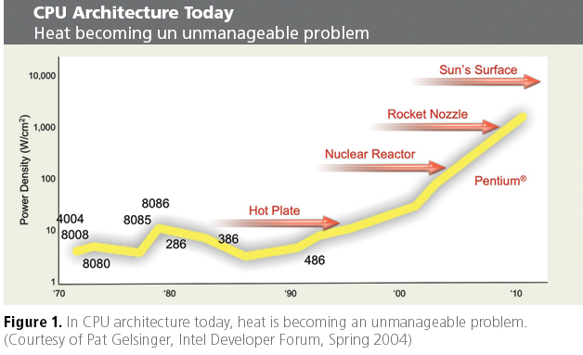
Increase in Power Density

Slide 6
The Power Wall
Going with Moore’s Law results in too much heat dissipation and power consumption
Moore’s law still holds but does not seem to be economically viable
The multicore paradigm
Put multiple simplified (and slower) processing cores on the same chip area
Fewer transistors per cm² implies less heat!

Slide 7
Why is Multicore Such a Big Deal?
longer issue pipeline
double speed arithmetic
more responsibility on software
Full Speed Level 2 Cache
instruction pipeline
16 MHz
25 MHz

Slide 8
Why is Multicore Such a Big Deal?
Parallelism is mainstream
“In future, all software will be parallel”
- Andrew Chien, Intel CTO (many concur)
Parallelism no longer a matter of interest just for the HPC people
Need to find more programs to parallelize
Need to find more parallelism in existing parallel applications
Need to consider parallelism when writing any new program

Slide 9
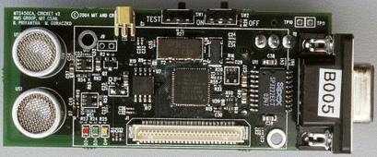
Why is Multicore Such a Big Deal?
Parallelism is Ubiquitous

Slide 10
OS Role in the Multicore Era
There are several considerations for multicore operating systems
Scalability
Sharing and contention of resources
Non-uniform communication latency
Biggest challenge is in scheduling of threads across the system

Slide 11
Scheduling Goals
Most of the goals don’t change when scheduling for multicore or multi-processor systems
Still care about
CPU utilization
Throughput
Turnaround time
Wait time
Fairness
definitions may become more complex

Slide 12
Scheduling Goals for Multicore Systems
Multicore systems give rise to a new set of goals for the OS scheduler
Load balancing
Resource sharing
Energy usage and power consumption

Slide 13
Single CPU Scheduler Overview
Long-term Queue
Ready Queue
CPU
I/O
Queue

Slide 14
Multicore Scheduler Overview I
Common
Ready Queue
Core 0
Long-term Queue
Core 1
Common
I/O
Queue
Core 2
Core 3
Cores sharing the same short-term queues

Slide 15
Multicore Scheduler Overview II
Ready Queue
Core 0
end
Cores with individual ready queues
I/O
Queue
Ready Queue
Core 1
end
Long-term Queue
I/O
Queue
Ready Queue
Core 2
end
No special handling required for many of the single CPU scheduling algorithms
I/O
Queue
Ready Queue
Core 3
end
I/O
Queue

Slide 16
Load Balancing
Goal is to distribute tasks across all cores on the system such that CPU and other resources are utilized evenly
A load-balanced system will generally lead to higher throughput
BAD
GOOD
Scenario 1
Scenario 2

Slide 17
The OS as a Load Balancer
Main strategy
Identify metric for balanced load
average number of processes waiting in ready queues
(aka load average)
Track load balance metric
probe ready queues
uptime and who utilities
Migrate threads if a core exhibits a high average load
If load average for cores 0-3 is 2, 3, 1, and 17 then move threads from core3 to core 2

Slide 18
Thread Migration
The process of moving a thread from one ready queue to another is known as thread migration
Operating systems implement two types of thread migration mechanism
Push migration
Run a separate process that will migrate a thread from one core to another
May be integrated within the kernel as well
Pull migration (aka work stealing)
Each core fetches threads from other cores

Slide 19
Complex Load Balancing Issues
Assume only one thread executing on each core
Does it help to load balance this workload?
Will it make a difference in performance?
Thread migration or load balancing will only help with overall performance if t1 runs faster when moved to core0, core2 or core3

Slide 20
Load Balancing for Power
This unbalanced workload can have huge implications for power consumption
Power consumption is tied to how fast a processor is running
P = cv²f and P t
P = power, f = frequency,
c = static power dissipation
v = voltage and t = temperature
One core running at a higher frequency than the others may result in more heat dissipation and overall increased power consumption

Slide 21
Load Balancing for Power
Operating Systems are incorporating power metrics in thread migration and load balancing decisions
Achieve power-balance by eliminating hotspots
Can also try to change the frequency
AMD Powernow, Intel Sidestep
Can utilize hardware performance counters
core utilization
core temperature
Linux implements this type of scheduling
sched_mc_power_savings

Slide 22
Load Balancing Trade-offs
Thread migration may involve multiple context switch on more than one core
Context switches can be very expensive
Potential gains from load balancing must be weighed against the increased cost from context switches
Load balancing policy may conflict with CFS scheduling
balanced load does not imply fair sharing of resources

Slide 23
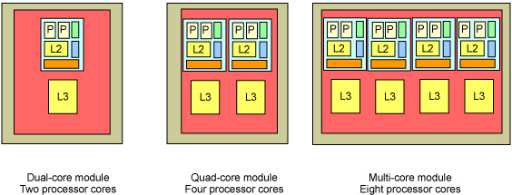
Resource Sharing
Current multicore and SMT systems share resources at various levels
OS needs to be aware of resource utilization in making scheduling decisions

Slide 24
Thread Affinity
Tendency for a process to run on a given core for as long as possible without being migrated to a different core
aka CPU affinity and processor affinity
The operating system uses the notion of thread affinity in performing resource-aware scheduling on multicore systems
If a thread has affinity for a specific core (or core group) then priority should be given to schedule the map and schedule the thread to that specific core (or group)
Current approach is to use thread affinity to address skewed workloads
Start with default (all cores)
Set affinity of task I to core j if core j is deemed underutilized

Slide 25
Adjusting Thread Affinity
Linux kernel maintains the task_struct data structure for every process in the system
Affinity information is stored as a bitmask in the cpus_allowed field
Can modify or retrieve the affinity of a thread from user-space
sched_setaffinity(), sched_getaffinity()
pthread_setaffinity_np(), pthread_getaffinity_np()
taskset
demo

Slide 26
Thread Affinity in the Linux Kernel
/* Look for allowed, online CPU in same node. */
for_each_cpu_and(dest_cpu, nodemask, cpu_active_mask)
if (cpumask_test_cpu(dest_cpu, &p->cpus_allowed))
return dest_cpu;
/* Any allowed, online CPU? */
dest_cpu = cpumask_any_and(&p->cpus_allowed, cpu_active_mask);
if (dest_cpu < nr_cpu_ids)
return dest_cpu;
/* No more Mr. Nice Guy. */
if (unlikely(dest_cpu >= nr_cpu_ids)) {
dest_cpu = cpuset_cpus_allowed_fallback(p);
/*
* Don't tell them about moving exiting tasks or
* kernel threads (both mm NULL), since they never
* leave kernel.
*/
if (p->mm && printk_ratelimit()) {
printk(KERN_INFO "process %d (%s) no "
"longer affine to cpu%d\n",
task_pid_nr(p), p->comm, cpu);
}
}
Linux kernel 2.6.37, sched.c

Slide 27
Affinity Based Scheduling
Affinity based scheduling can be performed under different criteria, using different heuristics
Assume 4 cores with two L2 shared between core 0 and core 1, core 2 and core 3, L3 shared among all cores
L3
L2
L2
L1
L1
L1
L1
Core 0
Core 1
Core 2
Core 3

Slide 28
Affinity Based Scheduling
P
C
Shared
Data in L2
time
P
reuse of data
reuse of data
reuse of data
C
Scheduling for data locality in L2
A thread t_{i} that shares data with t_{j} should be placed in the same affinity group
Can lead to unbalanced ready-queues but improved memory performance

Slide 29
Affinity Based Scheduling
L3
Poor schedule for producer-consumer program
L2
L2
L1
L1
L1
L1
Core 0
Core 1
Core 2
Core 3
P
P
C
C
L3
L2
L2
Good schedule for producer-consumer program
L1
L1
L1
L1
Core 0
Core 1
Core 2
Core 3
P
C
P
C

Slide 30
Affinity Based Scheduling
Scheduling for better cache utilization
Thread t_{i} and t_{j} only utilize 10% of the cache, t_{p} and t_{q} each demand 80% of the cache
Schedule t_{i} and t_{p} on core 0 and core 1, t_{j} and t_{q} on core 2 and core 3
May lead to loss of locality
L3
L2
L2
L1
L1
L1
L1
Core 0
Core 1
Core 2
Core 3
t_{i}
t_{p}
t_{j}
t_{q}

Slide 31
Affinity Based Scheduling
Scheduling for better power management
t_{i} and t_{j} are CPU-bound while t_{p} and t_{q} are memory-bound
Schedule t_{i} and t_{p} on core 0 and t_{j} and t_{q} to core 2
L3
L2
L2
L1
L1
L1
L1
Core 0
Core 1
Core 2
Core 3
t_{i} + t_{p}
t_{j} + t_{q}

Slide 32
Gang Scheduling
Two-step scheduling process
Identify a set (or gang) of threads to and adjust affinity for them to execute in a specific core group
Gang formation can be done based on resource utilization and sharing
Suspend the threads in a gang to let one job have dedicated access to the resources for a configured period of time
Traditionally used for MPI programs running on high-performance clusters
Becoming mainstream for multicore architectures
Patches available that integrates gang scheduling with CFS in Linux

